Slide 1

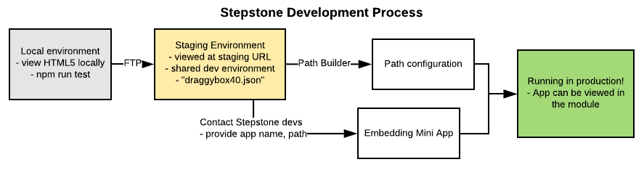


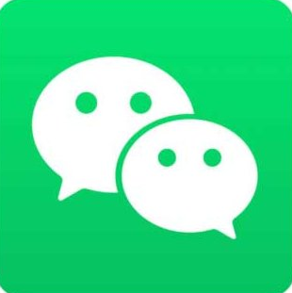

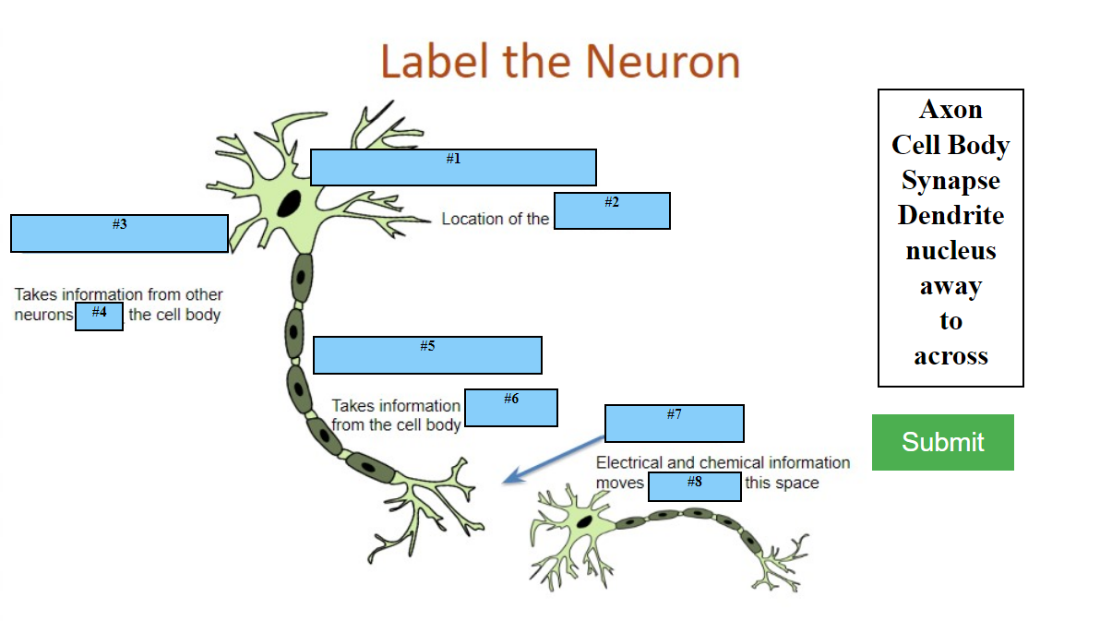
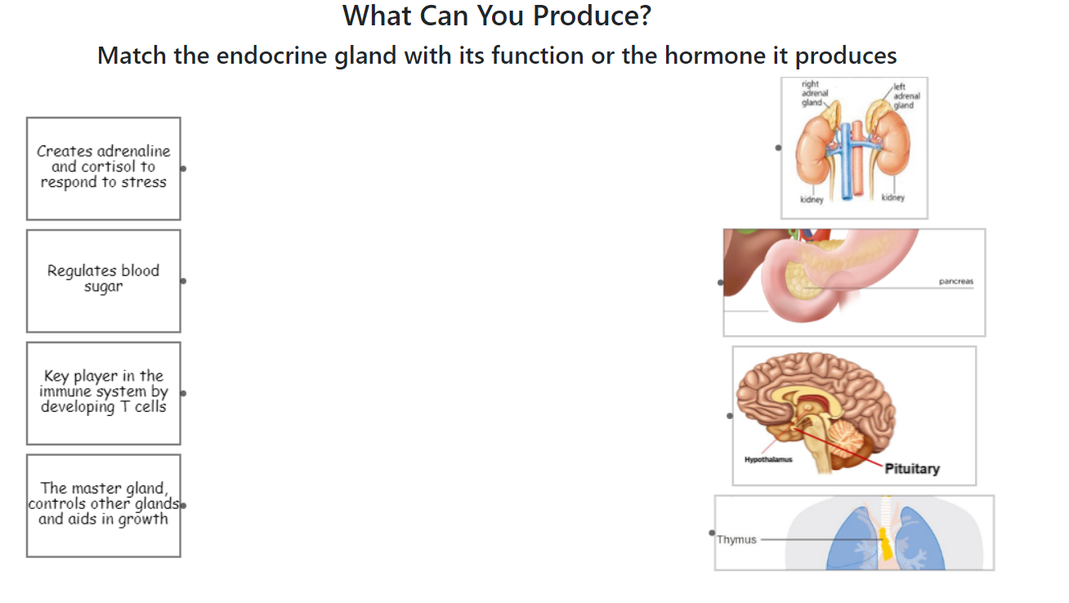
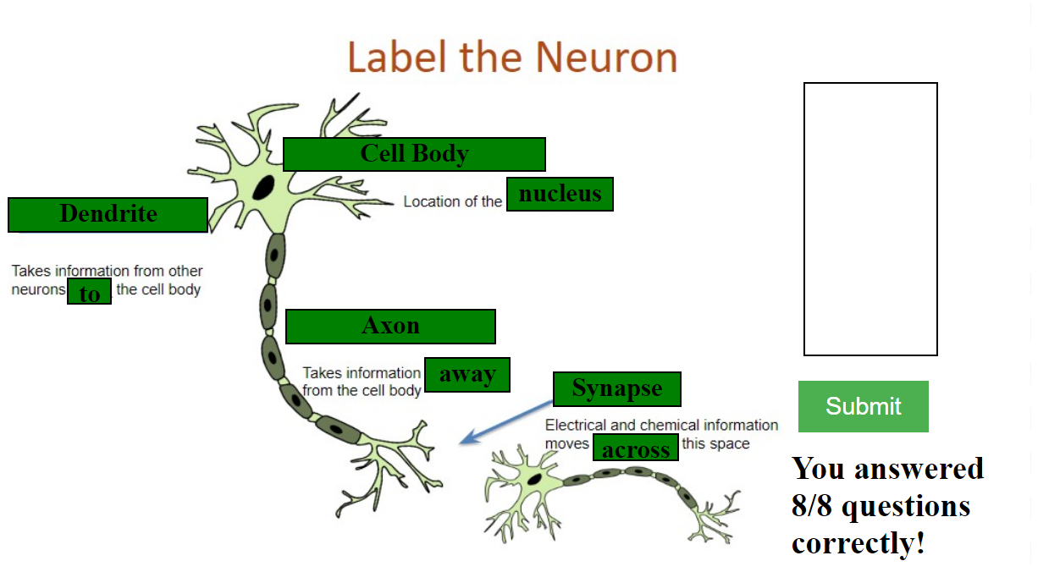
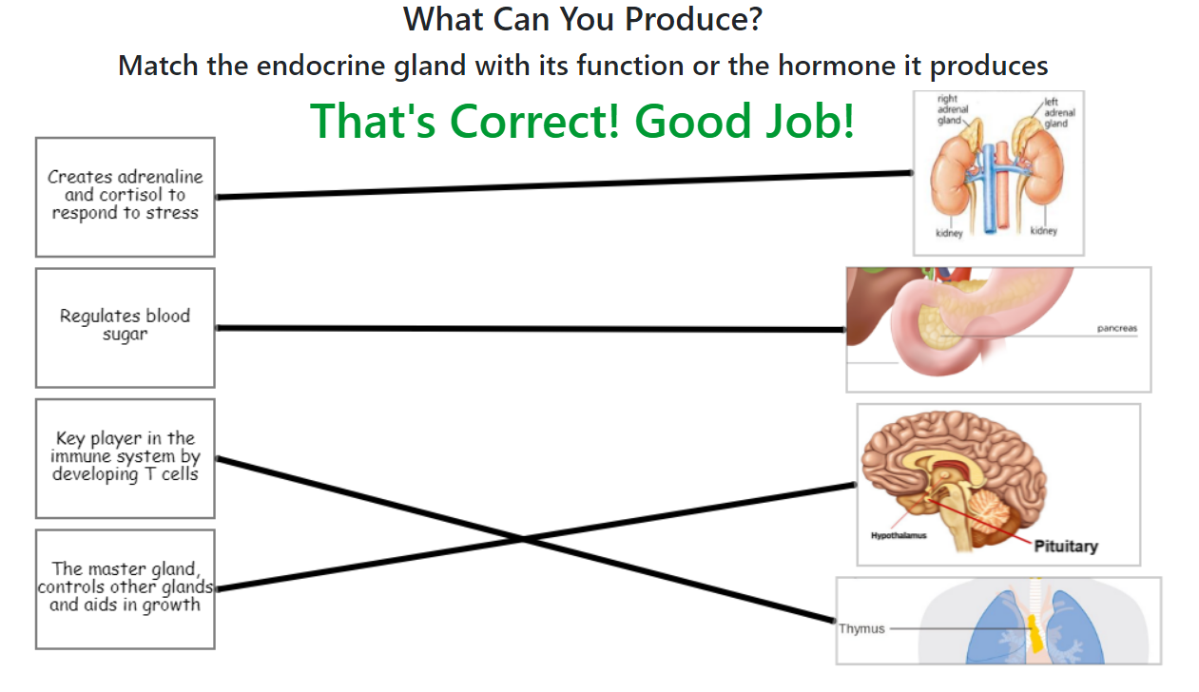
Animations in Stress Learning Content
Final Poster
Jincheng Li, Ruxin Zhang, Jia Fu, Wenlin Li, Ruichao Wang, Xiaomu Dong
Introduction
The Stepstone Environment
The website of Veterinary medicine & Biomedical sciences of Texas A&M University
Part of the One health curriculum which aims at providing basic biology knowledge through a series of online courses
Our focus is on the Stress Module, and our main goal is to program mini app animations for interactive student learning
StepStone is a web-based tool designed for educators without special technical or programming experience so they can create engaging, educational content
The path-building environment offers ways to make content paths, embed pictures, videos, questions and answers, etc., but does not provide support for more complex animations or games. Mini-apps, custom implementations of these animations, need to be manually embedded into the slides and cannot interact with any built in StepStone events and UI.
The development process for StepStone from your local machine to the production URL includes: creating a mini-app in local development, testing in the staging area which replicates the production environment (an FTP server and URL for viewing), production path configuration with Stepstone provided tools, and embedding the mini app in production.
Objectives
Make various Stress Module slides more interactive and engaging for students to enhance their learning experience
Polish the legacy code of previous group to make it bug free and improve the user experience of the customers.
Enable each animation, or mini-app, to be browser compatible, mobile-friendly, heavily tested, and deployed to production in the StepStone environment
Allow mini-apps to be reusable for future slides and animations
Organization
Mini-app Design
The development process followed the Agile methodology with 3 iterations, each spanning a one-week period
The team consisted of Product Owner (Jincheng Li), Scrum Master (Xiaomu Dong), and four other developers
On a weekly basis, the team had a zoom meeting with the teaching assistant to report our progress and address our problems
Each iteration, the team met with our customer to update and receive feedback on progress. We used Google drive for use stories, Wechat for constant communication, Zoom for team and customer meetings, and GitHub for version control
Each mini-app was built with HTML5, JavaScript, and CSS
The test is conducted both locally and in Stepstone environment
Each group member is assigned a user story to finish, and the product owner is responsible for the test in Stepstone environment and giving feedback and revise suggestions
Examples of the animations designed
Drag and Drop Animation
Drag and Connect Animation
Difficulties
Lack of experience in JavaScript especially in JQuery.
The StepStone environment is sandboxed in an “iframe” element which caused various sizing and loading problems
The staging environment (FTP server and staging URL) was shared across multiple developers, so only one developer could test their app at a time
To deploy our mini apps, the StepStone developers had to manually embed them into the slides in production
User drags the correct terms to the boxes
User connects the correct lines
Results
Future Steps
The team completed and deployed the slides requires user interaction animation: Hangman (slide 20), Connect Lines(slide 12, 42), Drag and Drop (slide 24, 54,66), and Word Selection (slide 33).
These animations are currently in production in their respective slide numbers within the Stress Module.
All completed user stories are compatible with most browsers (Chrome, Edge, Firefox, Safari).
All completed user stories are touch screen compatible except for Drag and Drop (slide 24,54, 66).
Automated tests cases were written for all completed user stories to ensure future reusability and development.
The team worked with the Stepstone environment and documented in detail for future teams.
These animations can be reusable by other Stepstone modules with minimal changes to code and content.
Every Stepstone module has the potential to benefit from the use of these apps or the integration of new ones, and teams are already gradually implementing them for various modules.
Stepstone needs an automated process of placing the finished mini-apps in production by each individual developer to enable faster turn-around during iterations.
Adding support for interaction between Stepstone and the mini-apps to allow Stepstone do declare dynamic content and allow the mini-app interactions to prevent progress through the module steps.
Lessons Learned
Communication is of vital importance, both within the team and with the customer. Maintain constant communication facilitate progress of the project.
Future teams will benefit a lot from thorough documentation.
Constant test guarantees the completion of user stories.
Creating a development environment that simulates the production environment helps ensure deployments go as smoothly as possible and minimizes debugging in production.
The initial phases of organization, setup, and research can be the hardest part of the development process.

